Slide 1
Design

Slide 2
Software Design
Software design is a mechanism to transform user requirements into some suitable form, which helps the programmer in software coding and implementation. It deals with representing the client's requirement, as described in SRS (Software Requirement Specification) document, into a form, i.e., easily implementable using programming language.

Slide 3
Why software design is important?
Better designed software is more Flexible. So, you can add a new component to the existing software without affecting the existing software.
Well-designed software increases Reusability. Because if you follow design patterns strictly, your software would be more modular.
Easy to understand. It has been always a headache to explain projects to new hires/team members. But if you have good design & documentation, you can easily communicate the idea of the software to your new team member.

Slide 4
Why software design is important?
Cost-efficiency is increased. You might be thinking how can designing can affect the cost of the software. To understand this, consider a situation in which you and your team started building software based on some assumptions, but after developing 50% of the software, you realize that you’ve met a dead-end and you can’t go ahead with those assumptions. Now, you’ll have to start the software again which would definitely be very costly. So, if you’ve focused on the design first, you could have figured out the dead-end earlier and saved a lot of time, work-force and money. Always remember, “Designing is far more cost-efficient than developing”

Slide 5
Software Design Approaches
Top-down design:
The top-down approach, also known as step-wise design, essentially breaks a system or model down into component sub-systems, each of which may broken down further.
Bottom-up Design
The bottom up design model starts with most specific and basic components. It proceeds with composing higher level of components by using basic or lower level components.
It keeps creating higher level components until the desired system is not evolved as one single component. With each higher level, the amount of abstraction is increased.
Bottom-up Approaches is more suitable when a system needs to be created from some existing system, where the basic primitives can be used in the newer system

Slide 6
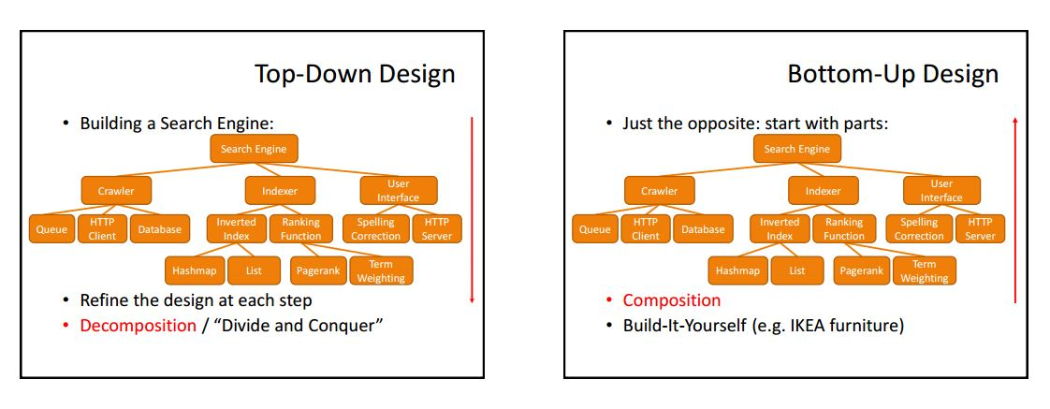

Slide 7
Software Design Approaches
Top-down design
Advantages
It has a strong focus on specific requirements that help to make a design responsive to its requirements.
At each step of refinement, the new parts become less complicated and, therefore, easier to figure out.
Disadvantages
Component-reuse is missed as the system boundaries are specification oriented
Misses the benefits of well-structured simple architecture.

Slide 8
Software Design Approaches
Bottom-up design
Advantages
General solution can be reused
It can hide low-level details of implementation
Disadvantages
It is not so closely related to structure of the problem
It may not fit a given need
Hard to construct and thus under-designed
It leads to proliferation of potentially useful functions rather than the most appropriate ones

Slide 9
Software Design Strategies
Function-oriented design
The system is viewed as something that performs a set of functions. This function may consist of sub-functions which may be split into more detailed sub-functions.
These functions are capable of performing significant task in the system
The system state is centralized and shared among different functions
Top Down approach
DFD is used
Design Process
The whole system is seen as how data flows in the system by means of data flow diagram.
DFD depicts how functions changes data and state of entire system.
The entire system is logically broken down into smaller units known as functions on the basis of their operation in the system.
Each function is then described at large.

Slide 10
Object-oriented design
The system is viewed as a collection of objects.
The system state is decentralized among the objects and each object manages its own state information.
Objects have their own internal data which define their state. Similar objects constitute a class.
Objects communicate by message passing.
Bottom-up approach

Slide 11
What is a component?
A software component is a modular building block for computer software
It is a modular, deployable, and replaceable part of a system that encapsulates implementation and exposes a set of interfaces
A component communicates and collaborates with
Other components
Entities outside the boundaries of the system
Three different views of a component
An object-oriented view
A conventional view
A process-related view

Slide 12
What is Comp. Level Design?
-“Effective programmers should not waste their time debugging – they should not introduce bugs to start with.” Edsgar Dijkstra
A component-level design can be represented using some intermediate representation (e.g. graphical, tabular, or text-based) that can be translated into source code
Component-level design defines the data structures, algorithms, interface characteristics, and communication mechanisms allocated to each component.

Slide 13
Designing
Class-Based Components

Slide 14
Object-oriented View
A component is viewed as a set of one or more collaborating classes
Each problem domain (i.e., analysis) class and infrastructure (i.e., design) class is elaborated to identify all attributes and operations that apply to its implementation
This elaboration activity is applied to every component defined as part of the architectural design
Once this is completed, the following steps are performed
Provide further elaboration of each attribute, operation, and interface
Specify the data structure appropriate for each attribute
Design the algorithmic detail required to implement the processing logic associated with each operation
Design the mechanisms required to implement the interface to include the messaging that occurs between objects

Slide 15
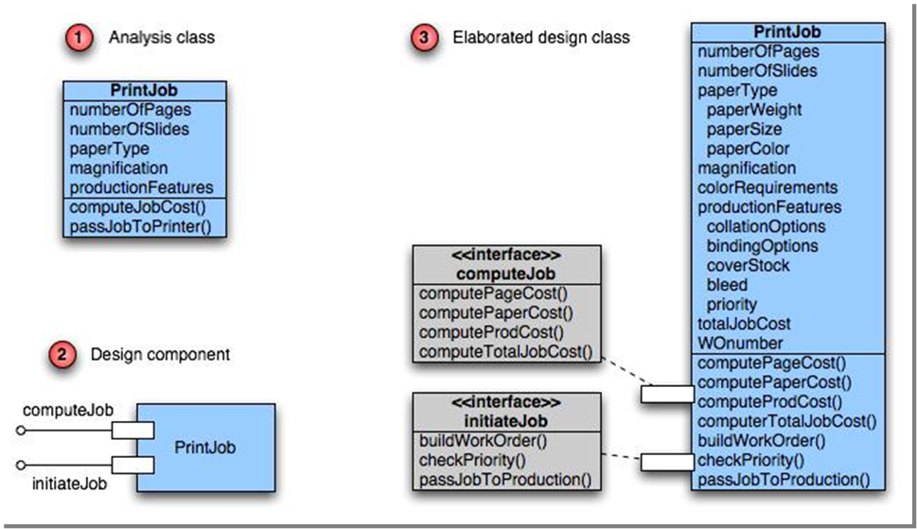
Class Elaboration

Slide 16
Component-level Design Principles
Open-closed principle
A module or component should be open for extension but closed for modification.
The designer should specify the component in a way that allows it to be extended without the need to make internal code or design modifications to the existing parts of the component.
Liskov substitution principle
Subclasses should be substitutable for their base classes
A component that uses a base class should continue to function properly if a subclass of the base class is passed to the component instead.

Slide 17
Component-level Design Principles
Dependency inversion principle
Depend on abstractions (i.e., interfaces); do not depend on concretions.
The more a component depends on other concrete components (rather than on the interfaces) the more difficult it will be to extend.
Interface segregation principle
Many client-specific interfaces are better than one general purpose interface.
For a server class, specialized interfaces should be created to serve major categories of clients.
Only those operations that are relevant to a particular category of clients should be specified in the interface .

Slide 18
Component-Level Design Steps
Identify design classes in problem domain
Identify infrastructure design classes
Elaborate design classes
Describe persistent data sources
Elaborate behavioral representations
Elaborate deployment diagrams
Refactor design and consider alternatives

Slide 19
Steps 1 & 2 – Identify Classes
Most classes from the problem domain are analysis classes created as part of the analysis model.

Slide 20
Step 3 – Class Elaboration
Specify message details when classes or components collaborate.
Identify appropriate interfaces for each component.
Elaborate attributes and define data structures required to implement them.
Describe processing flow within each operation in detail.

Slide 21
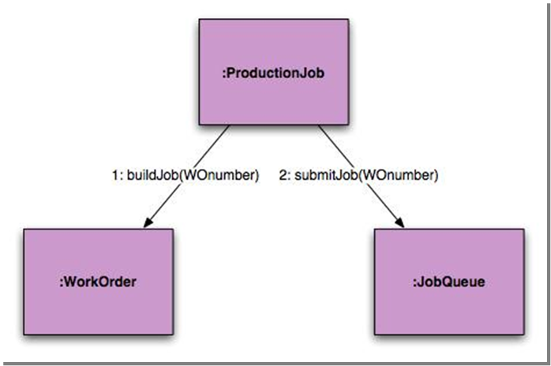
3a. Collaboration Details
Messages can be elaborated by expanding their syntax in the following manner:

Slide 22
3a. Collaboration Details
where a [guard condition] specifies any set of conditions that must be met before the message can be sent;
sequence expression is an integer value (or other ordering indicator, e.g., 3.1.2) that indicates the sequential order in which a message is sent;
(return value) is the name of the information that is returned by the operation invoked by the message;
message name identifies the operation that is to be invoked, and (argument list) is the list of attributes that are passed to the operation.

Slide 23
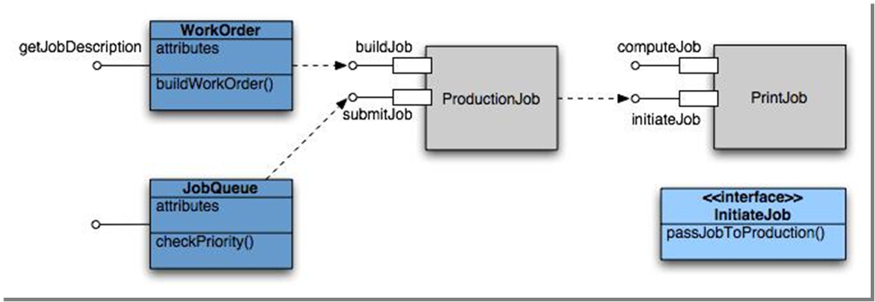
3b. Appropriate Interfaces

Slide 24
3c. Elaborate Attributes
In general, data structures and types used to define attributes are defined within the context of the programming language that is to be used for implementation.
name : type-expression = initial-value {property string}
where name is the attribute name, type expression is the data type, initial value is the value that the attribute takes when an object is created, and property-string defines a property or characteristic of the attribute.

Slide 25
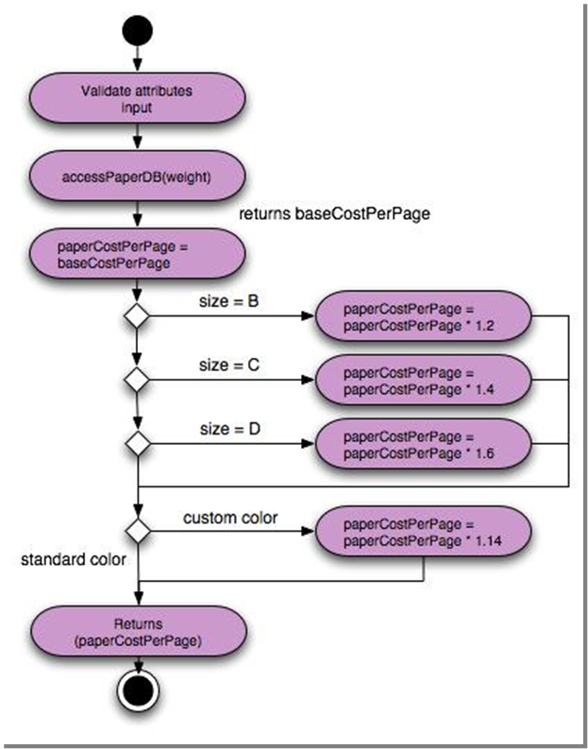
3d. Describe Processing Flow
Activity diagram for
compute Paper Cost( )

Slide 26
Step 4 – Persistent Data Step 5 – Elaborate Behavior
Describe persistent data sources (databases and files) and identify the classes required to manage them.
It is sometimes necessary to model the behavior of a design class.
Transitions from state to state have the form:
-Event-name (parameter-list) [guard-condition] / action expression

Slide 27
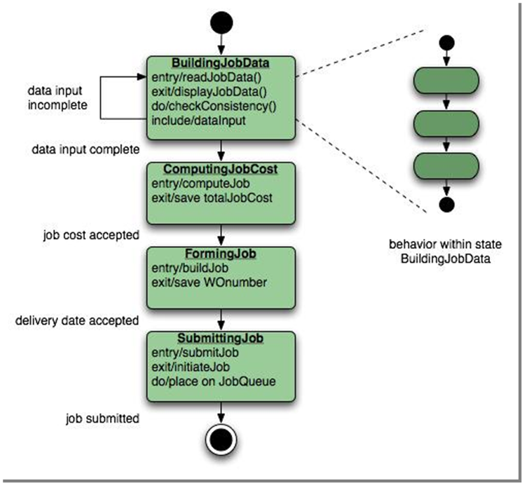

Slide 28
Step 6 – Elab. Deployment
Deployment diagrams are used as part of architectural design and are represented in descriptor form.
In this form, major system functions (often represented as subsystems) are represented within the context of the computing environment that will house them.
Deployment diagrams are elaborated to represent the location of key packages or components.
specific hardware and operating system environment(s) that will be used is (are) specified and the location of component packages within this environment is indicated.

Slide 29
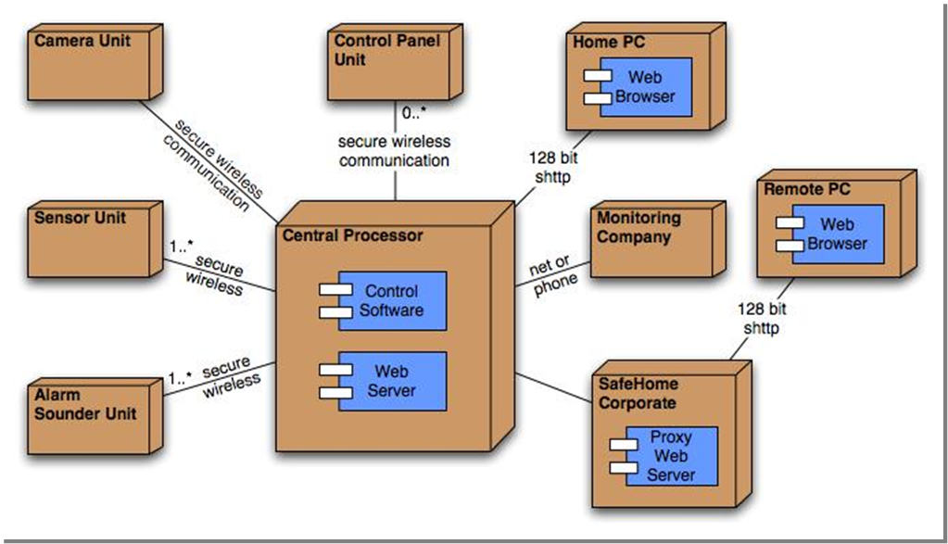

Slide 30
Step 7 – Redesign/Reconsider
The first component-level model you create will not be as complete, consistent, or accurate as the nth iteration you apply to the model.
The best designers will consider many alternative design solutions before settling on the final design model.

Slide 31
Designing
Conventional Components

Slide 32
Conventional View
A component is viewed as a functional element (i.e., a module) of a program that incorporates
The processing logic
The internal data structures that are required to implement the processing logic
An interface that enables the component to be invoked and data to be passed to it
A component serves one of the following roles
A control component that coordinates the invocation of all other problem domain components
A problem domain component that implements a complete or partial function that is required by the customer
An infrastructure component that is responsible for functions that support the processing required in the problem domain

Slide 33
Introduction
Conventional design constructs emphasize the maintainability of a functional/procedural program.
Sequence, condition, and repetition.
Each construct has a predictable logical structure where control enters at the top and exits at the bottom, enabling a maintainer to easily follow the procedural flow.
Elements of structured programming:
-Sequence implements processing steps that are essential in the specification of any algorithm.
-Condition provides the facility for selected processing based on some logical occurrence, and
-Repetition allows for looping.
These three constructs are fundamental to structured programming

Slide 34
Introduction
Various notations depict the use of these constructs
Graphical design notation
Sequence, if-then-else, selection, repetition
Tabular design notation
Program design language
Similar to a programming language; however, it uses narrative text embedded directly within the program statements

Slide 35
Graphical Design Notation
A picture is worth a thousand words,” but it’s rather important to know which picture and which 1000 words.
UML activity diagram or the flowchart, provide useful pictorial patterns that readily depict procedural detail.
However, if graphical tools are misused, the wrong picture may lead to the wrong software.
The activity diagram allows you to represent sequence, condition, and repetition—all elements of structured programming.

Slide 36
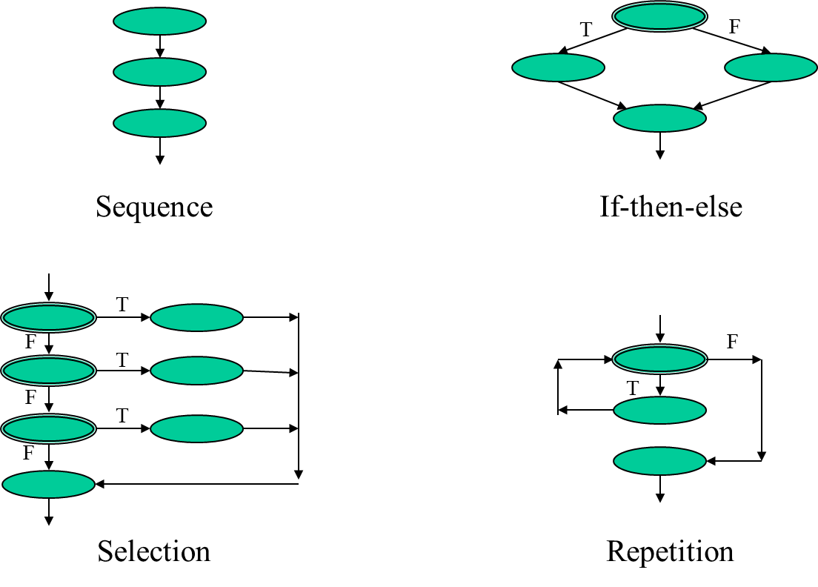
Graphical Design Notation

Slide 37
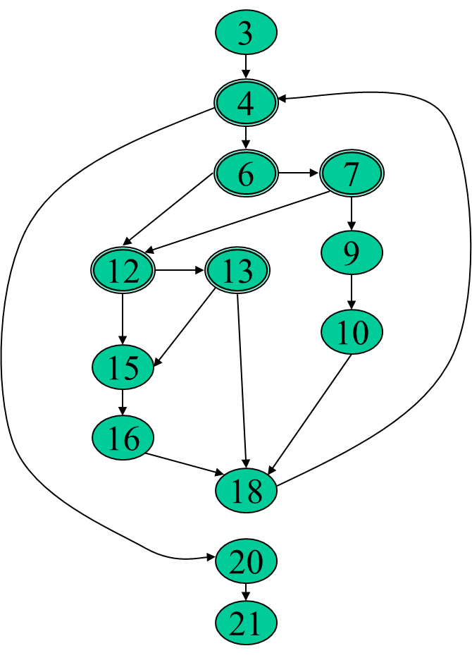
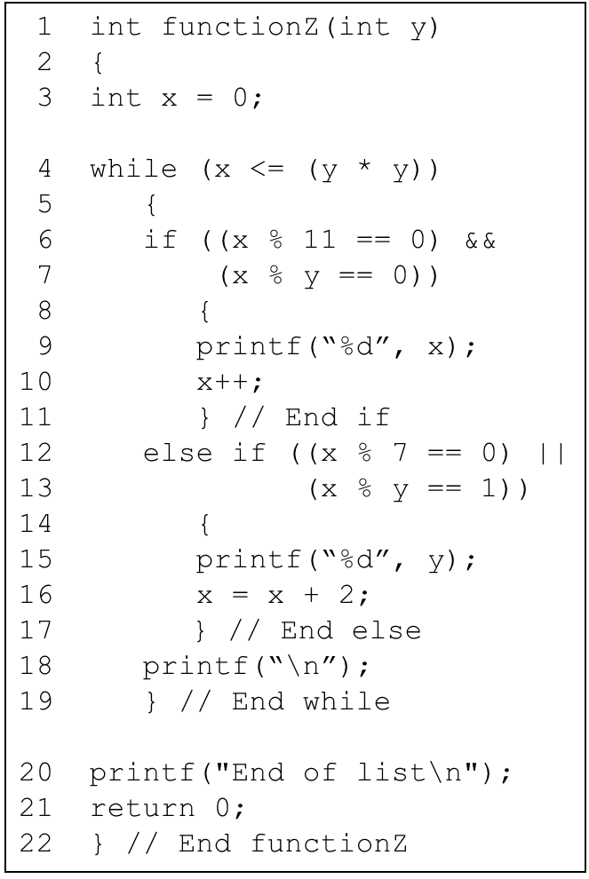
Graphical Example used for Algorithm Analysis

Slide 38
Tabular Design Notation
Decision tables provide a notation that translates actions and conditions(described in a processing narrative or a use case) into a tabular form.
Steps to formulate decision table:
List all actions that can be associated with a specific procedure (or module)
List all conditions (or decisions made) during execution of the procedure
Associate specific sets of conditions with specific actions, eliminating impossible combinations of conditions; alternatively, develop every possible permutation of conditions
Define rules by indicating what action(s) occurs for a set of conditions

Slide 39
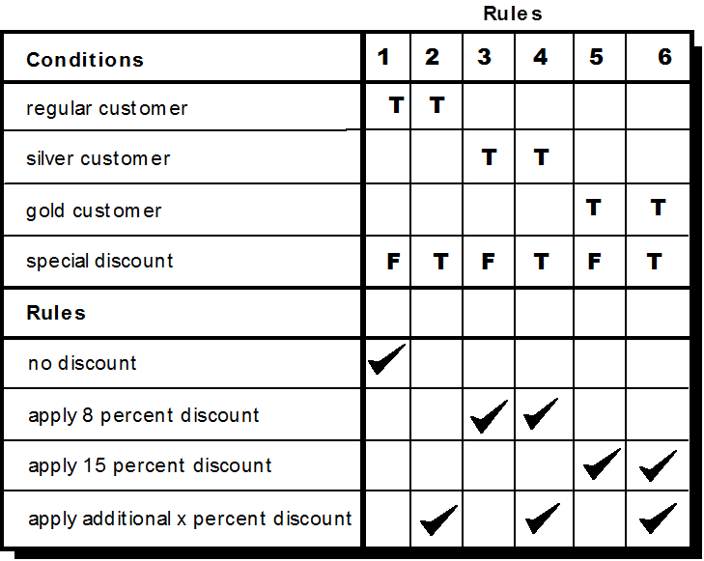
Tabular Design Notation

Slide 40
Three types of customers are defined: a regular customer, a silver customer, and a gold customer
A regular customer receives normal print rates and delivery.
A silver customer gets an 8 percent discount on all quotes and is placed ahead of all regular customers in the job queue.
A gold customer gets a 15 percent reduction in quoted prices and is placed ahead of both regular and silver customers in the job queue.
A special discount of x percent in addition to other discounts can be applied to any customer’s quote at the discretion of management.

Slide 41
Program Design Language(PDL)
Program design language (PDL), also called structured English or pseudo code, incorporates the logical structure of a programming language with the free-form expressive ability of a natural language (e.g., English).
Narrative text (e.g., English) is embedded within a programming language-like syntax.
Basic PDL syntax should include constructs for component definition, interface description, data declaration, block structuring, condition constructs, repetition constructs, and input-output (I/O) constructs.

Slide 42
The user interface
System users often judge a system by its interface rather than its functionality.
A poorly designed interface can cause a user to make catastrophic errors.
Poor user interface design is the reason why so many software systems are never used.

Slide 43
UI design principles
User familiarity
-The interface should be based on user-oriented terms and concepts rather than computer concepts. For example, an office system should use concepts such as letters, documents, folders etc. rather than directories, file identifiers, etc.
Consistency
-The system should display an appropriate level of consistency. Commands and menus should have the same format, command punctuation should be similar, etc.
Minimal surprise
-If a command operates in a known way, the user should be able to predict the operation of comparable commands

Slide 44
UI design principles
Recoverability
-The system should provide some resilience to user errors and allow the user to recover from errors. This might include an undo facility, confirmation of destructive actions, 'soft' deletes, etc.
User guidance
-Some user guidance such as help systems, on-line manuals, etc. should be supplied
User diversity
-Interaction facilities for different types of user should be supported. For example, some users have seeing difficulties and so larger text should be available

Slide 45
User-system interaction
Two problems must be addressed in interactive systems design
-How should information from the user be provided to the computer system?
-How should information from the computer system be presented to the user?
User interaction and information presentation may be integrated through a coherent framework such as a user interface metaphor.

Slide 46
Interaction styles
Direct manipulation
Menu selection
Form fill-in
Command language
Natural language

Slide 47
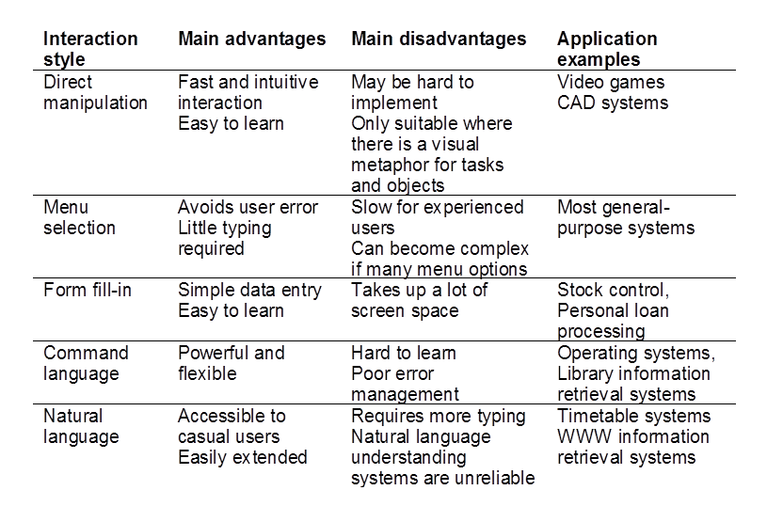
Advantages and disadvantages

Slide 48
Data visualization
Concerned with techniques for displaying large amounts of information
Visualization can reveal relationships between entities and trends in the data
Possible data visualizations are:
Weather information collected from a number of sources
The state of a telephone network as a linked set of nodes
Chemical plant visualized by showing pressures and temperatures in a linked set of tanks and pipes
A model of a molecule displayed in 3 dimensions
Web pages displayed as a hyperbolic tree

Slide 49
Color use guidelines
Don't use too many colors
Use color coding to support use tasks
Allow users to control color coding
Design for monochrome then add color
Use color coding consistently
Avoid color pairings which clash
Use color change to show status change
Be aware that color displays are usually lower resolution

Slide 50
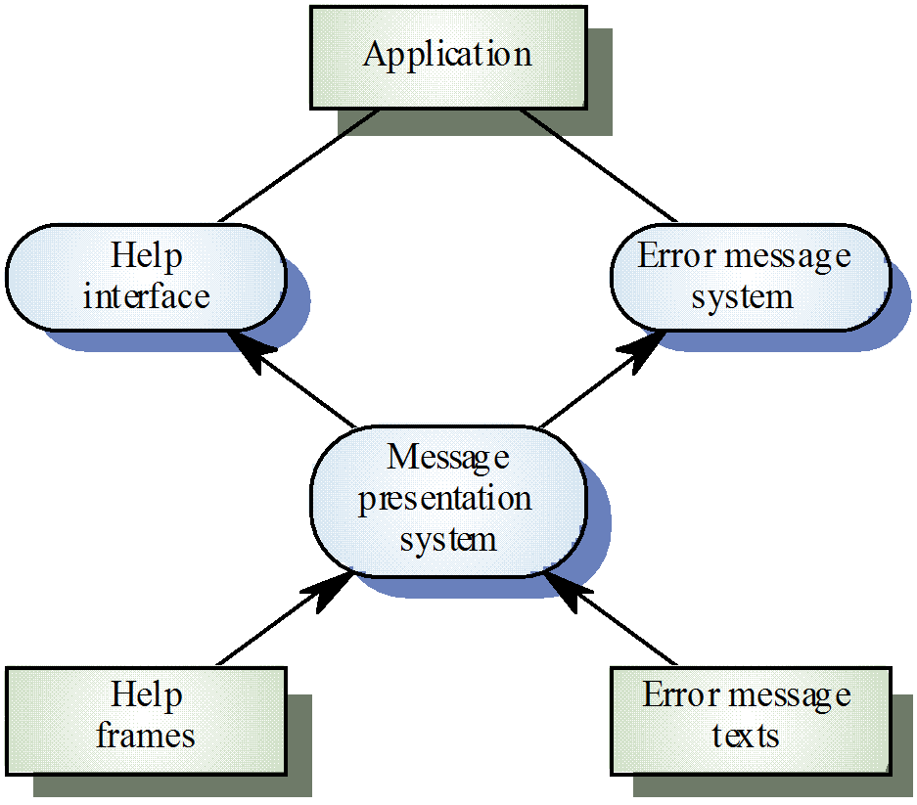
User support
User guidance covers all system facilities to support users including on-line help, error messages, manuals etc.

Slide 51
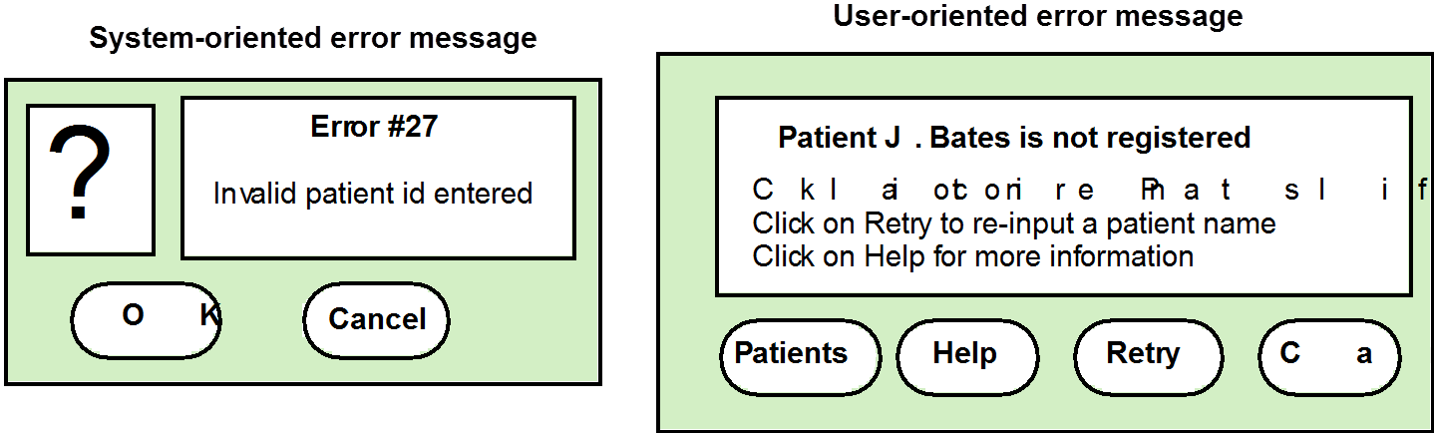
Error messages
Error message design is critically important. Poor error messages can mean that a user rejects rather than accepts a system.
The background and experience of users should be the determining factor in message design.

Slide 52
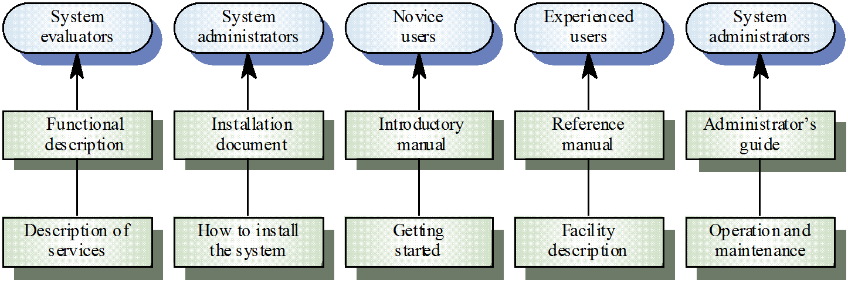
User document types

Slide 53
User document types
Functional description
-Brief description of what the system can do
Introductory manual
-Presents an informal introduction to the system
System reference manual
-Describes all system facilities in detail
System installation manual
-Describes how to install the system
System administrator’s manual
-Describes how to manage the system when it is in use

